Slide 1
Technology
At Highland Creek Elementary School
Home of the Hurricanes

Slide 2
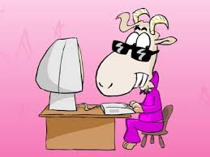
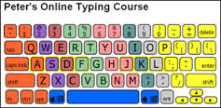
Students learn KeyBoarding with..
KeyBoard Zoo
DanceMat Typing
Peter’s Online Typing

Slide 3
Microsoft Office Skills...
Microsoft Word
Microsoft PowerPoint
“All About Me”
“My Spring Break”
“My American Hero”
“Save the earth every day on Earth Day”

Slide 4
Google Drive...In The Cloud
Google Slides
Google Doc

Slide 5
Reading and Math Skills…
Raz-Kids
Compass Learning
DreamBox

Slide 6
Computer Terms...
Computer Hardware
Computer Software
The Cloud
Internet
Computer Network
CPU
Operating System
Server
STEAM
STEM

Slide 7
Are you a Programmer?
Test your Programming Skills...
Click Here!

